Slide 1
NATIONAL ENVIRONMENT SCIENCE CAMP

Slide 2
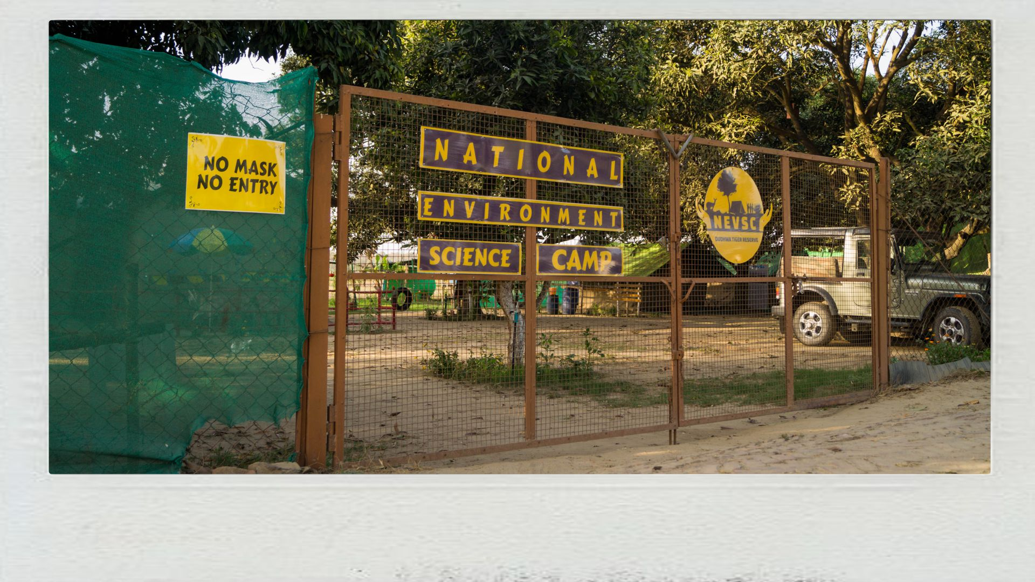
THE CAMPSITE IS FULLY FENCED.
MOST SAFE CAMPSITE IN DUDHWA TIGER RESERVE

Slide 3
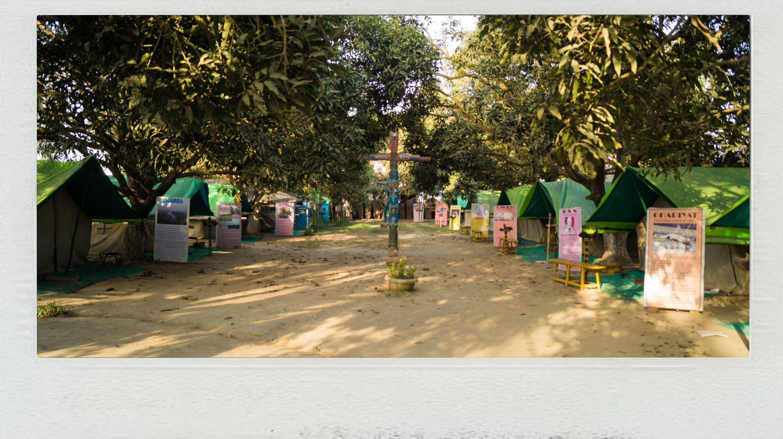
The Camp ground is spread over in an
area of almost One Acre

Slide 4
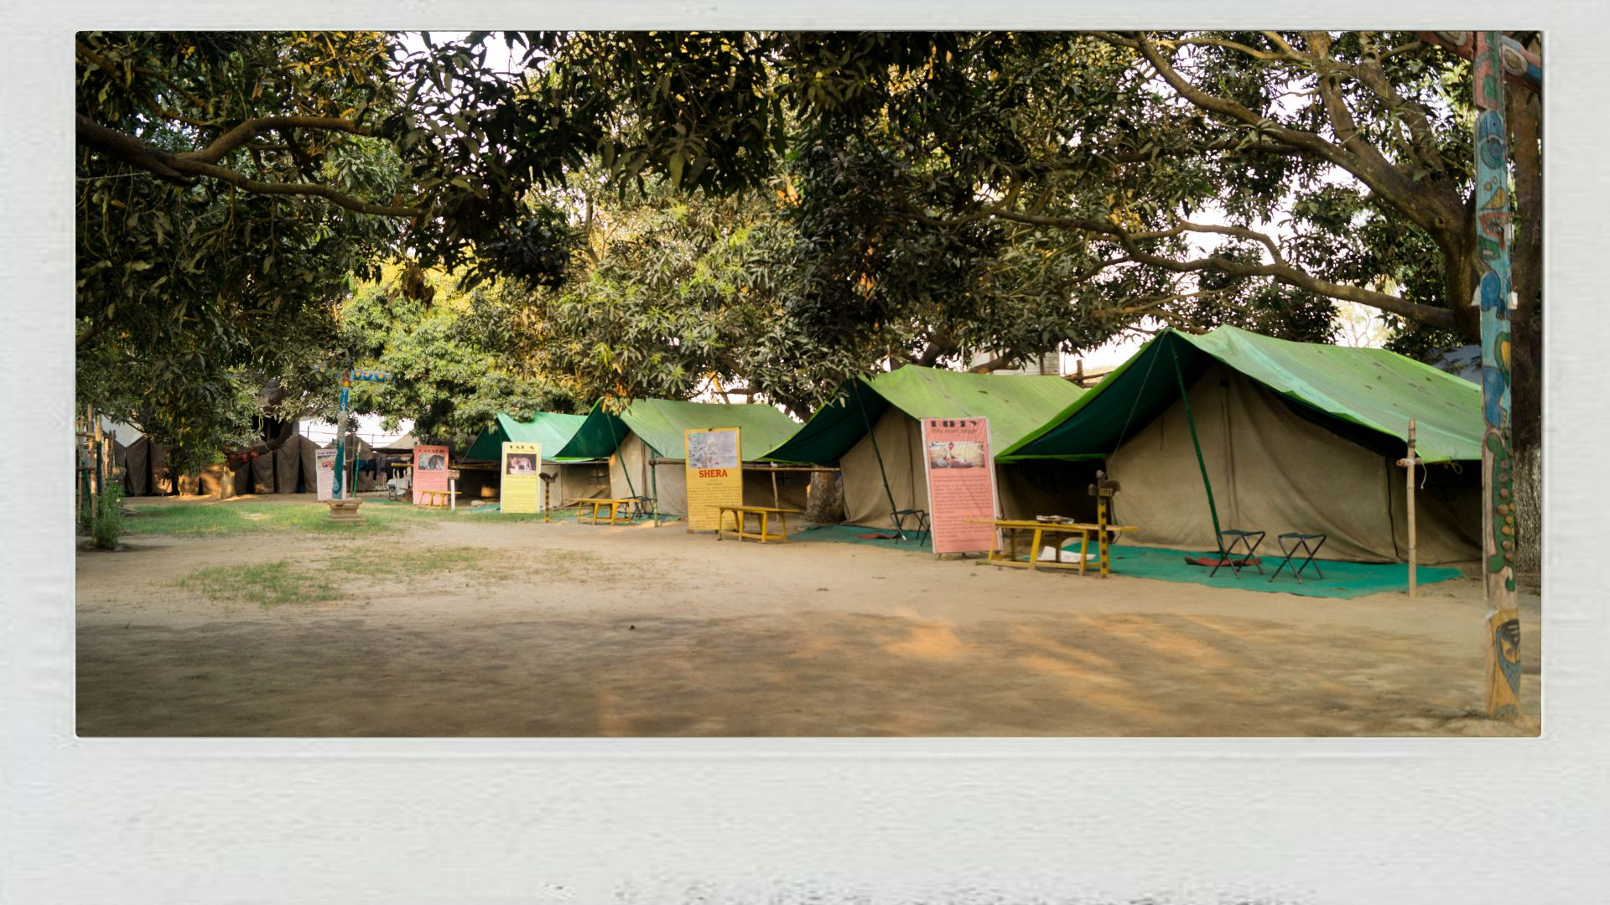
Full Camouflaged Jungle Tents in the Mango Orchard

Slide 5
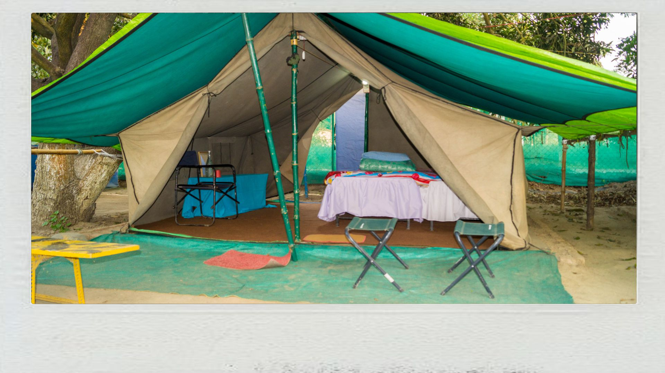
Canvas-made Jungle Tents
Protects from all the elements of the nature

Slide 6
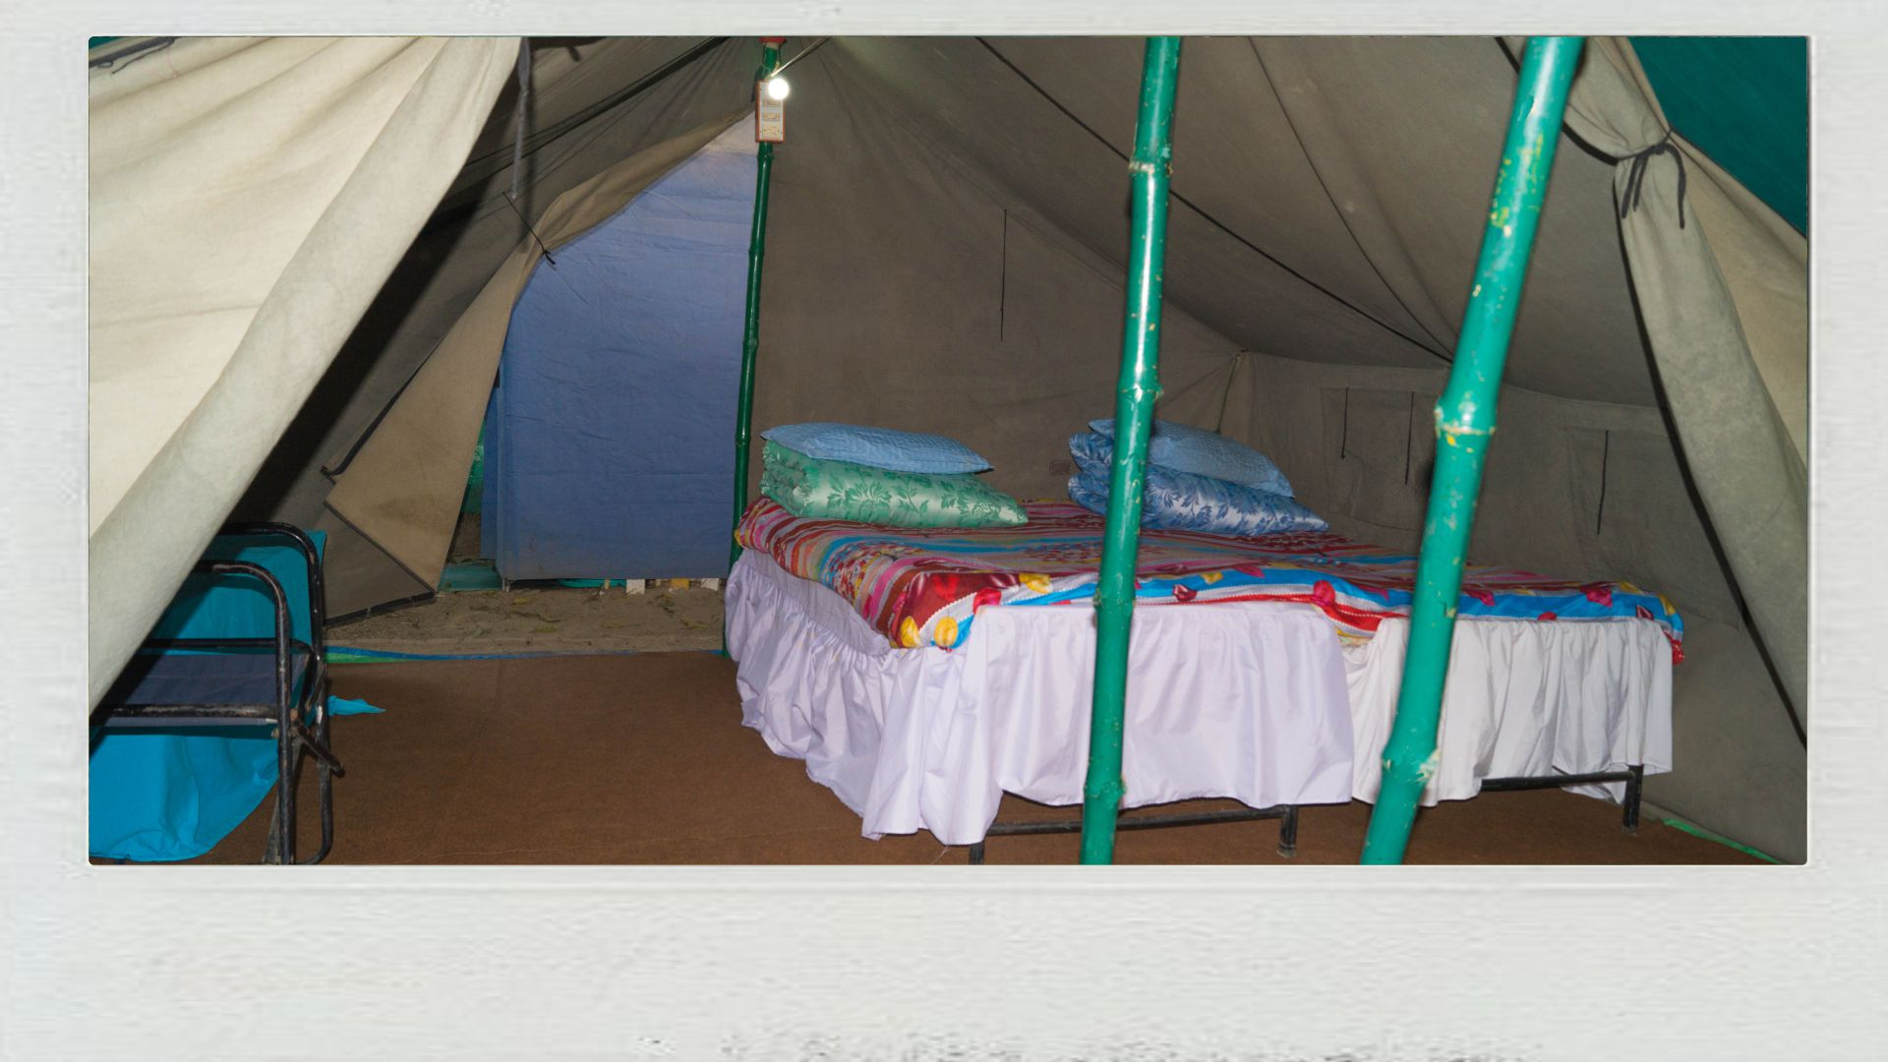
Comfortable, Warm and Sanitized Bedding
Includes Mattress, Pillow and Quilts

Slide 7
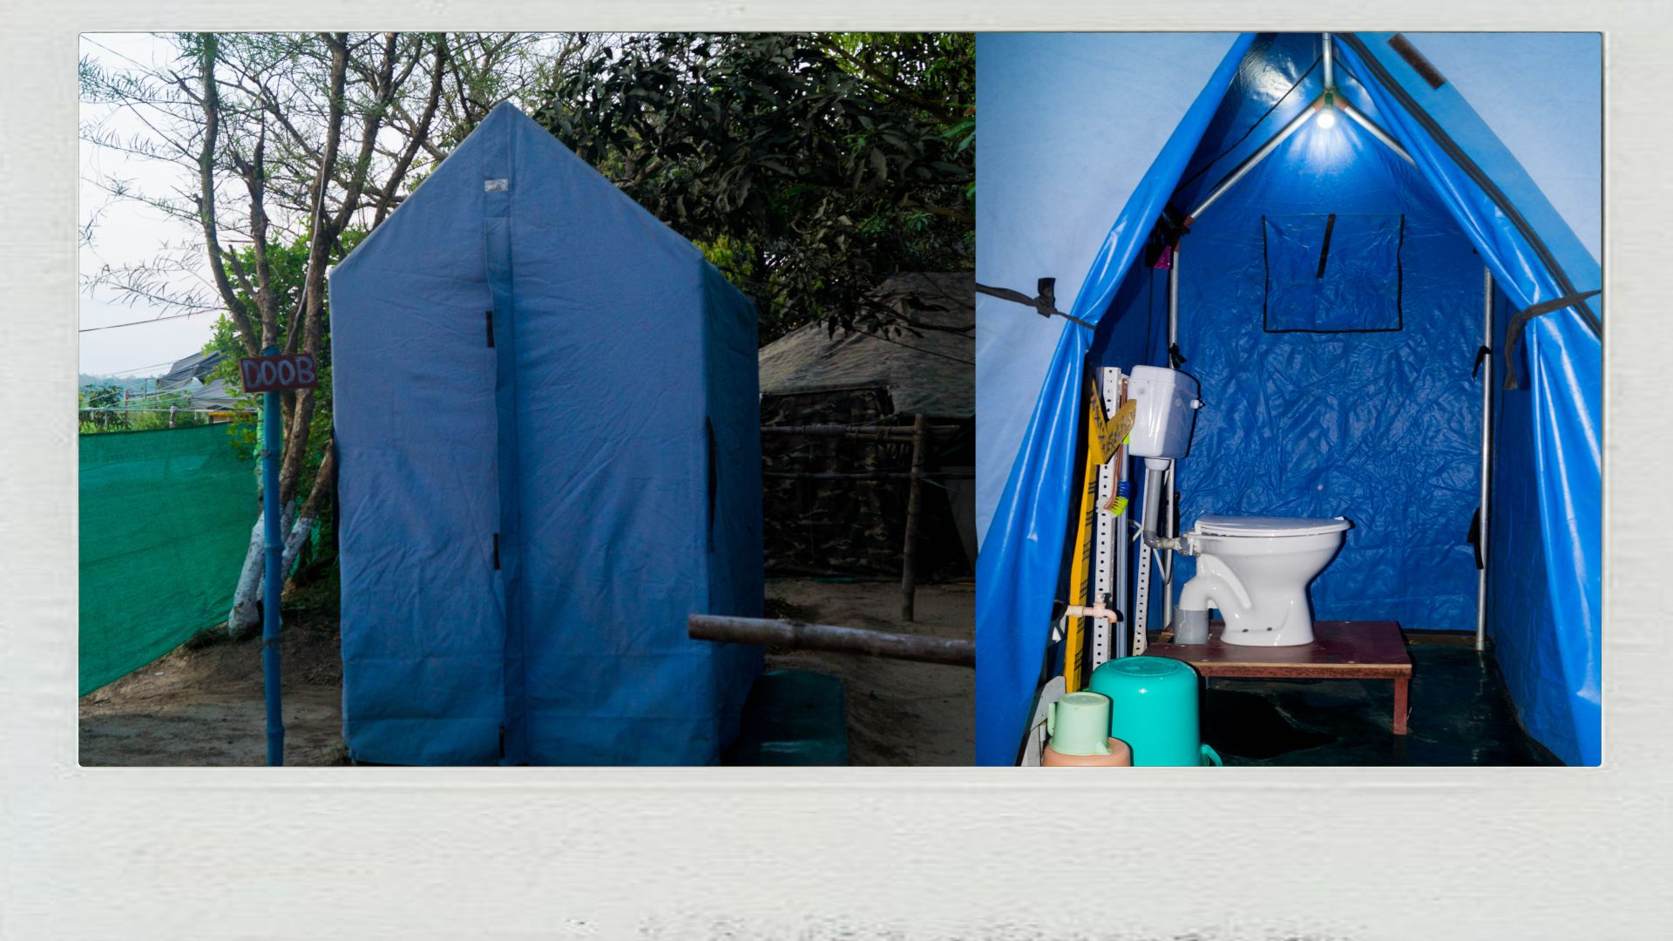
Secure and Hygienic Jungle Toilets Tents
with Hot/Cold Running Water Facility

Slide 8
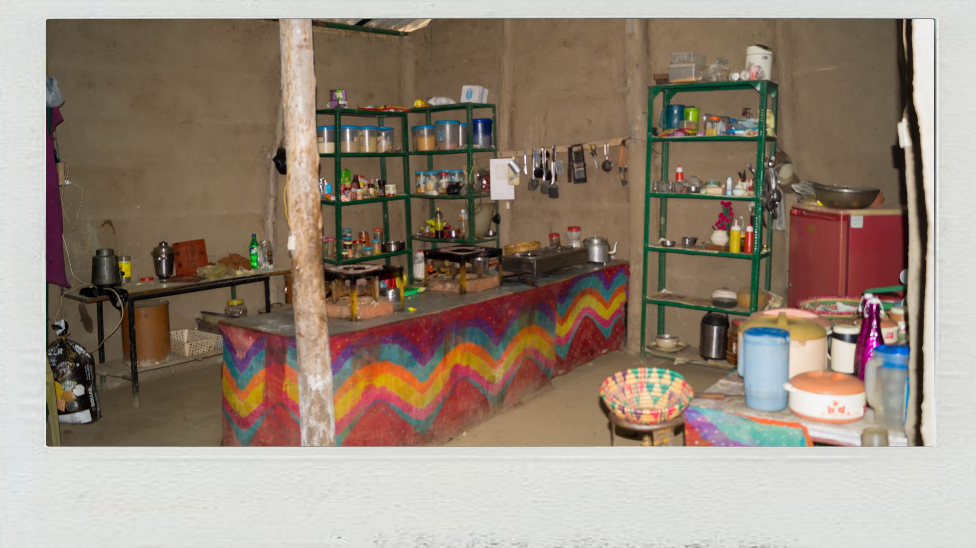
Clean and Hygienic Kitchen
Built on Tharu Tribal Architecture

Slide 9

Fresh, Delicious and Healthy Vegetarian Meals

Slide 10
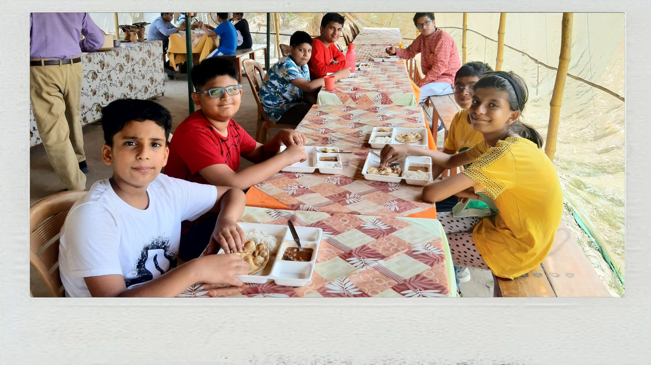
Served with love, Dining Area for Campers

Slide 11
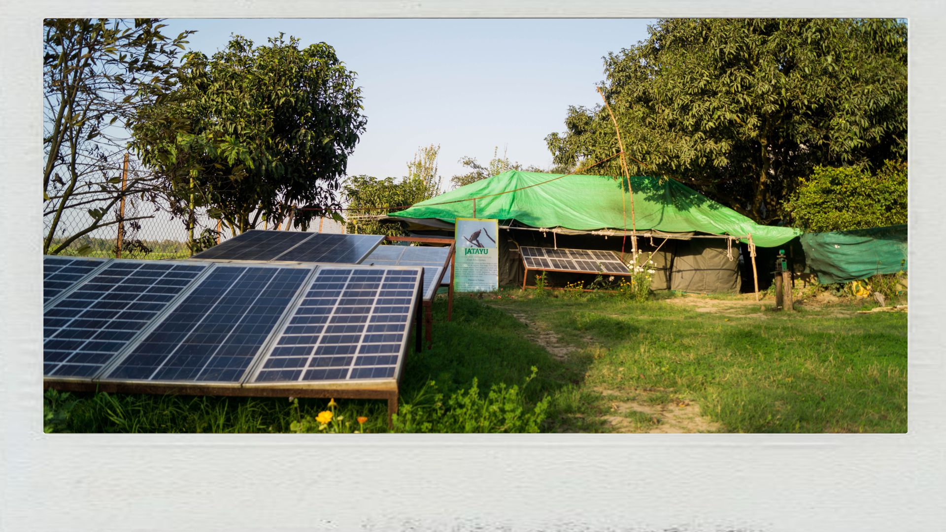
Camp is completely off-grid and runs on renewable energy

Slide 12
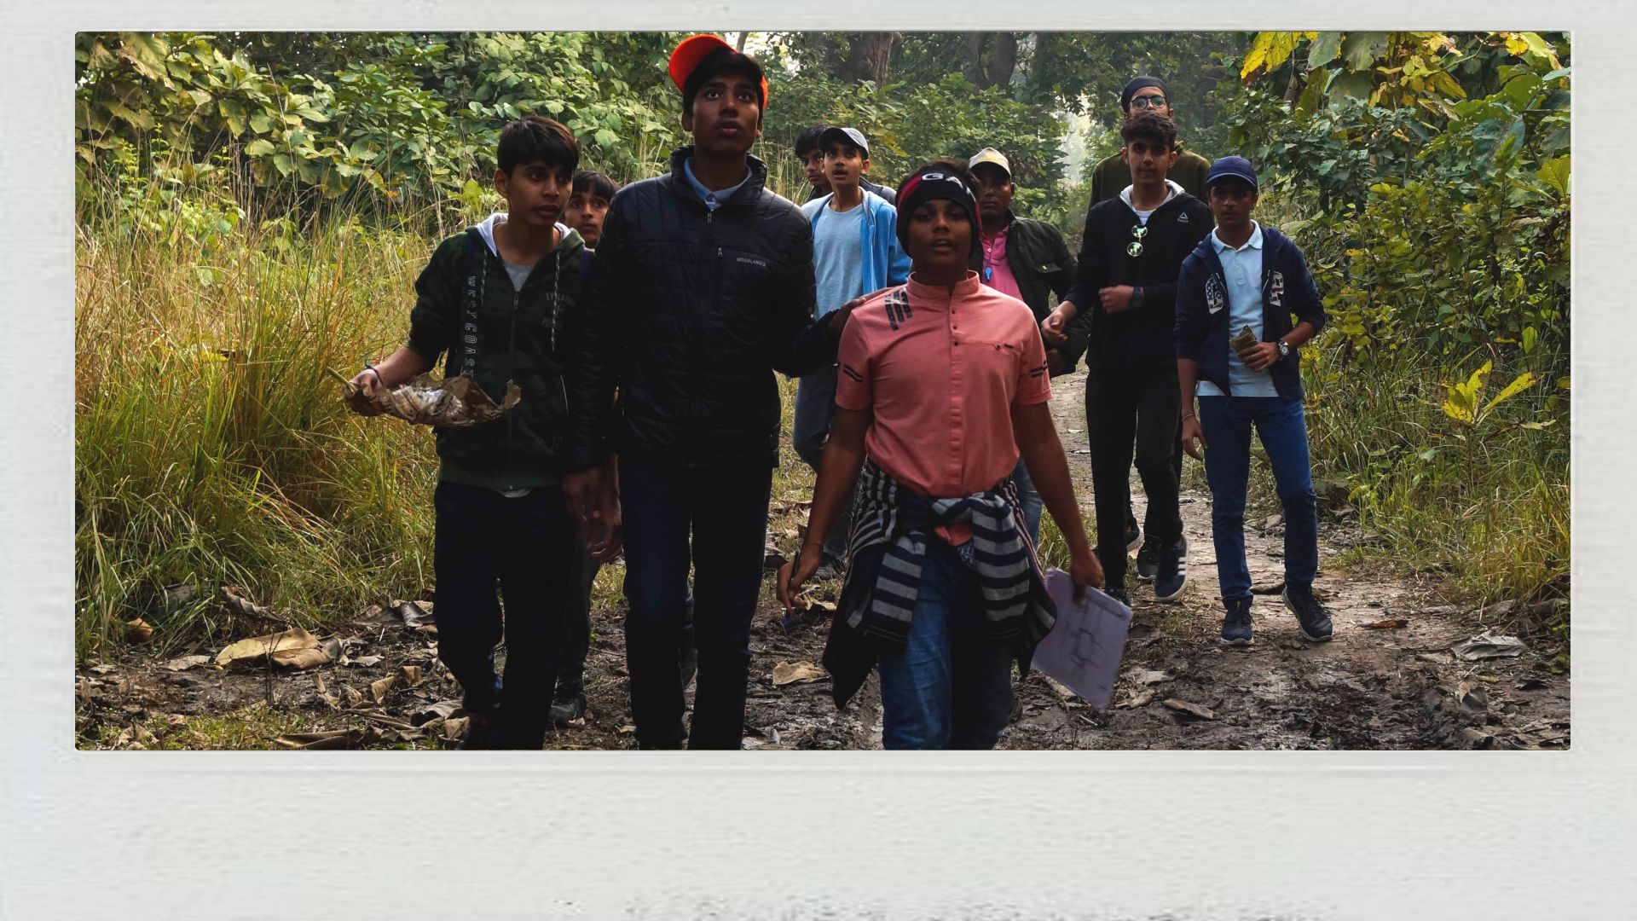
TIGER TRAIL
Walk through the Tiger’s Territory

Slide 13
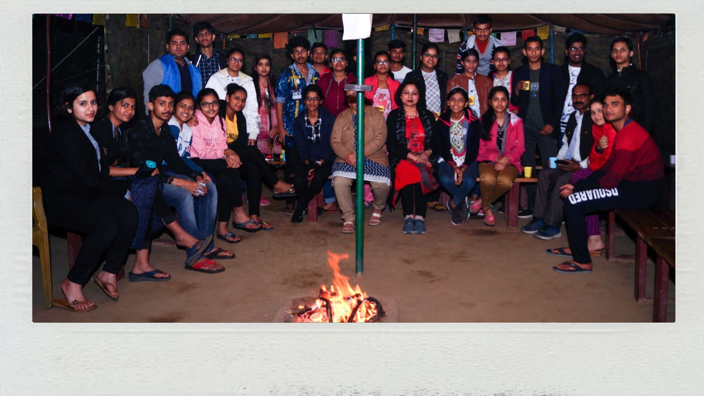
CAMPFIRE
Bond with fellow campers and listen to the legends of Dudhwa

Slide 14
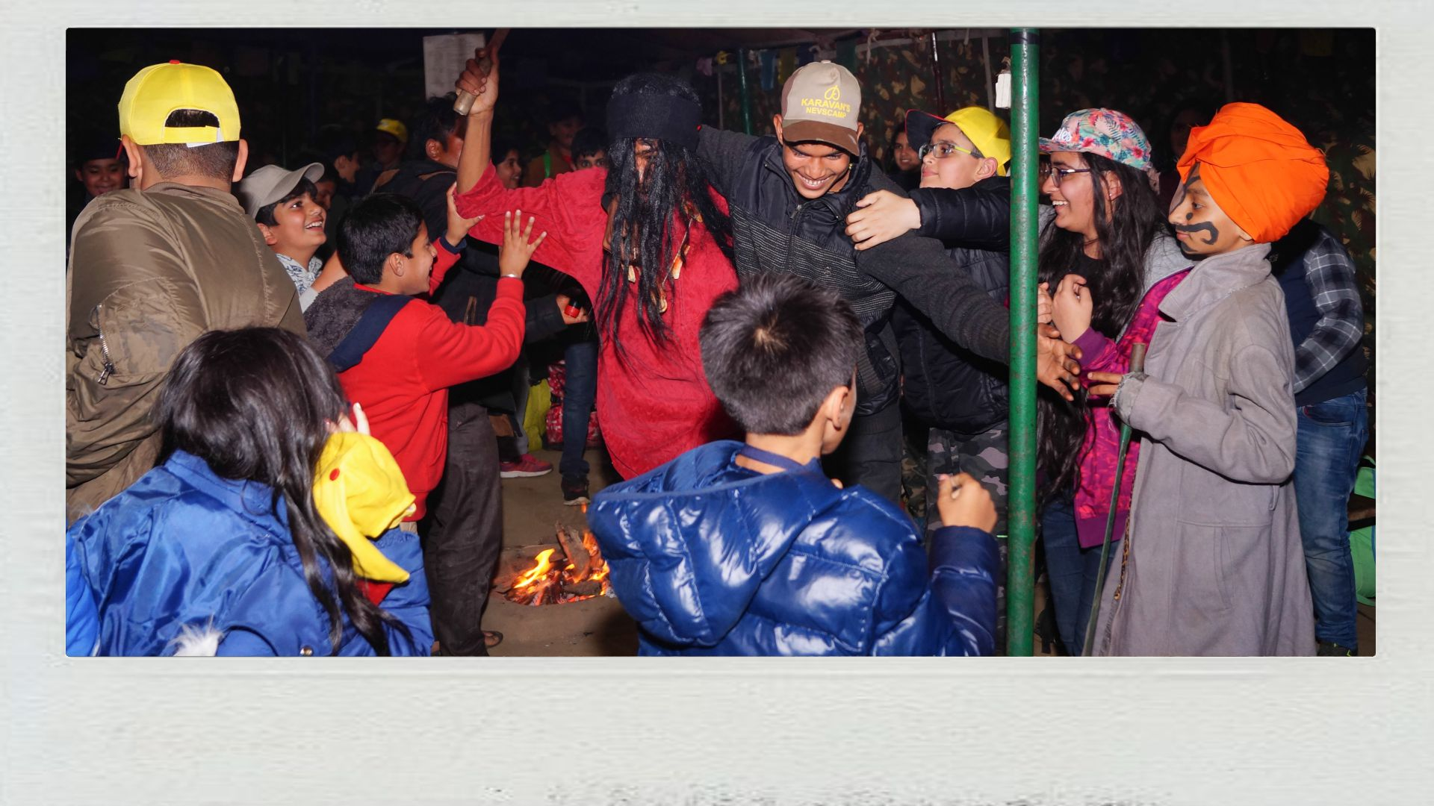
TERRA - X
Find the X-Factor of the Dudhwa Tiger Reserve

Slide 15
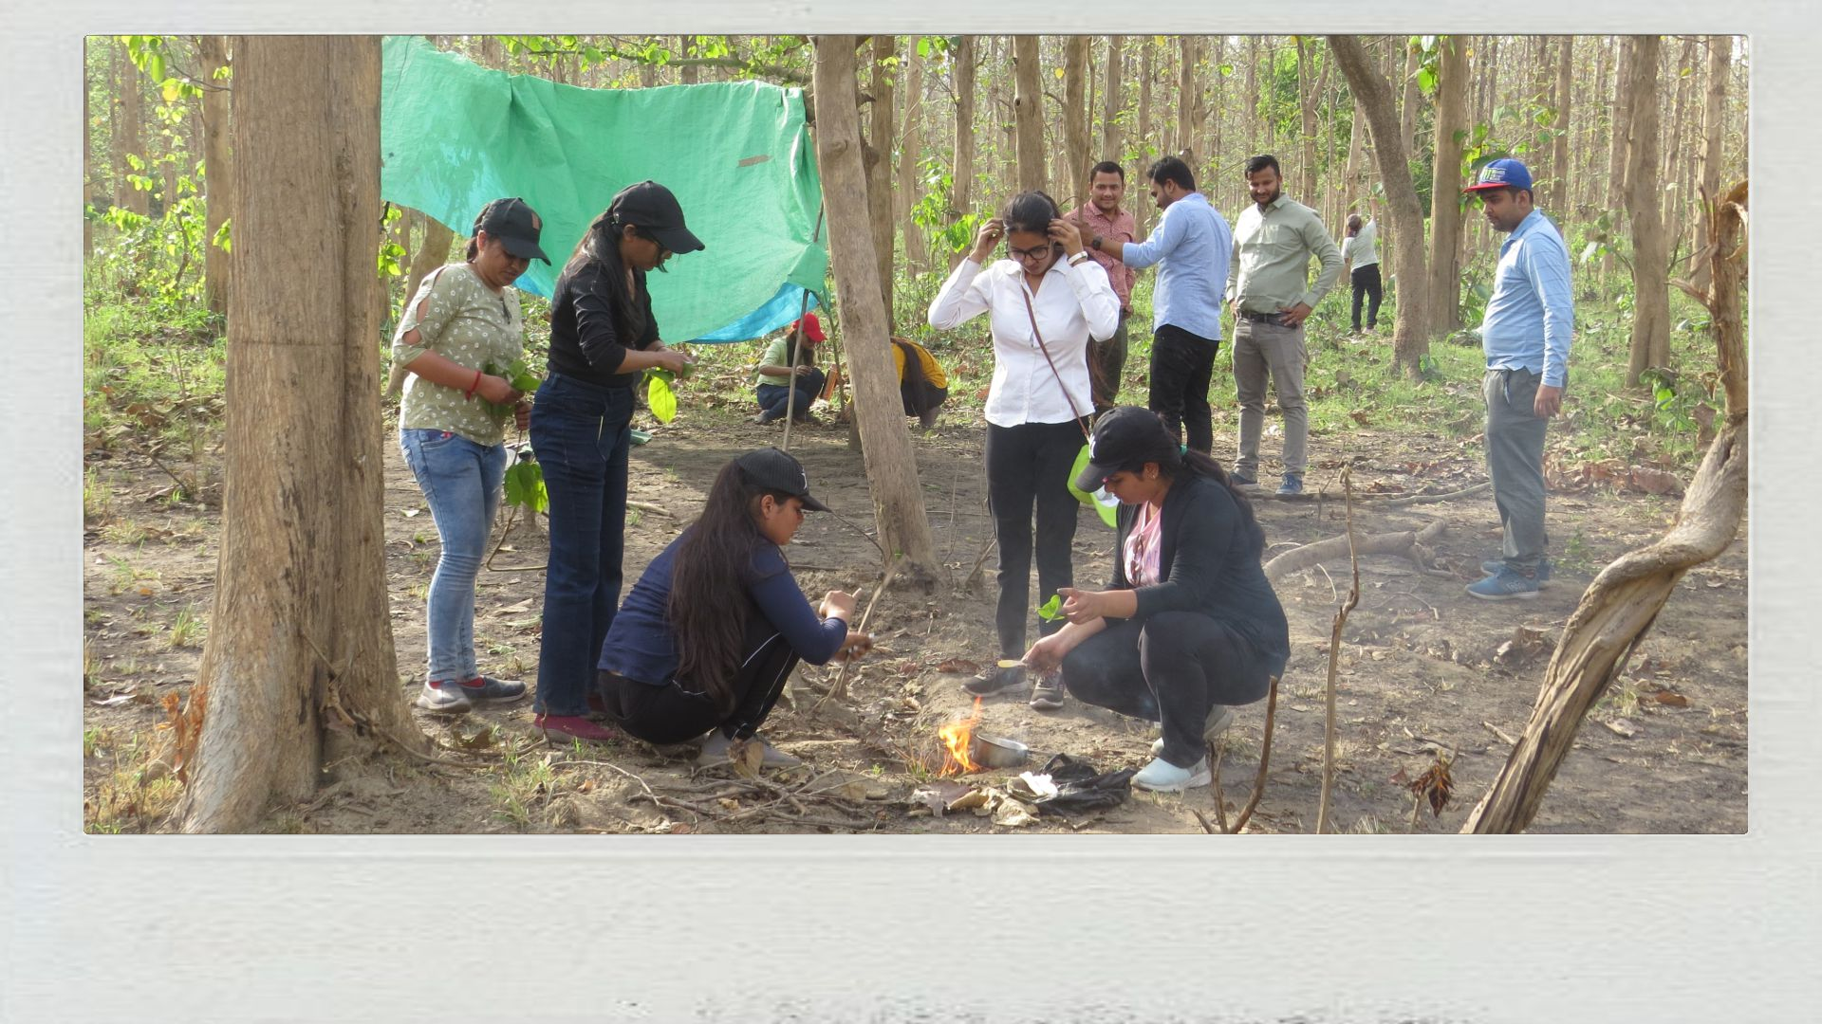
X’PEDITION
Learn the essentials of survival in the wilderness

Slide 16
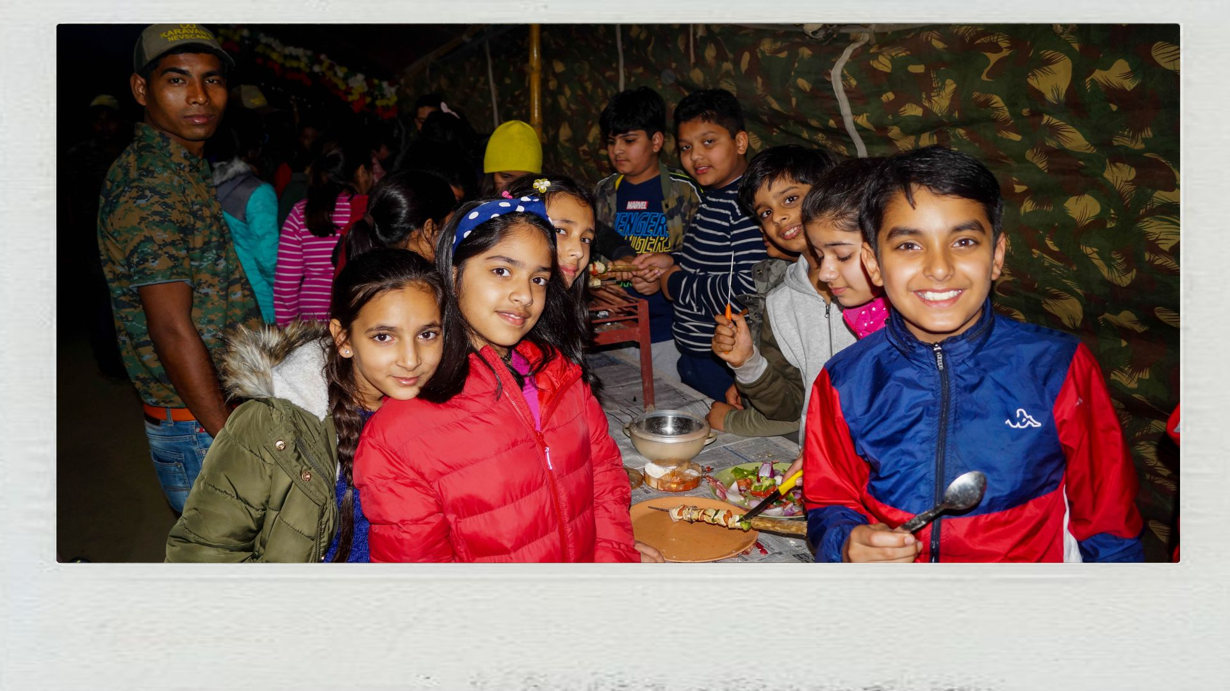
ELECTRIFIRE
Cooking in a primitive style

Slide 17
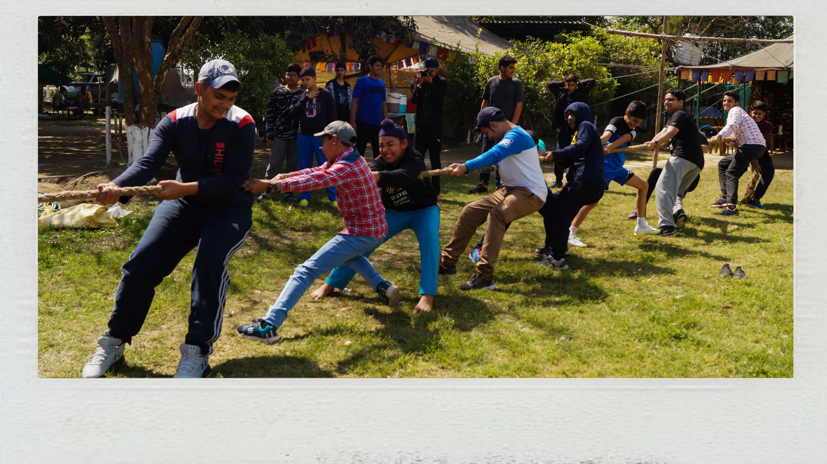
TEAM CAMPING GAMES
Strengthen existing relationships and cohesiveness

Slide 18
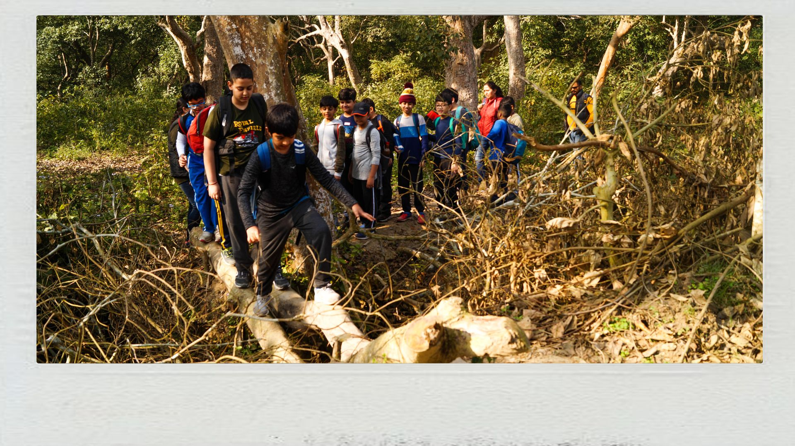
WADE THROUGH INDO-NEPAL BORDER
Experience the cross-country trek to a foreign country

Slide 19
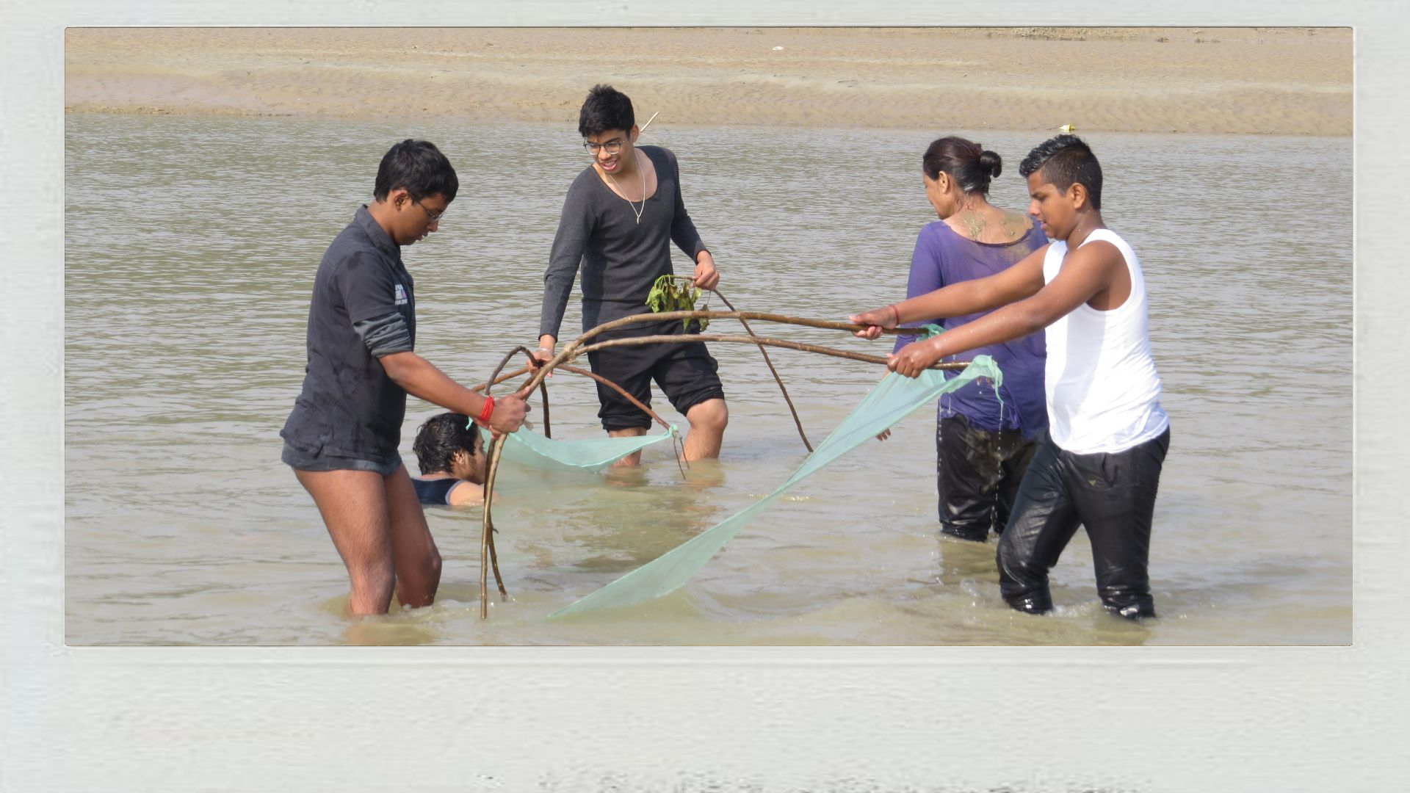
RIVER FUN & FROLICK
Fishing using the techniques of Tharu Tribals in the Mohana

Slide 20
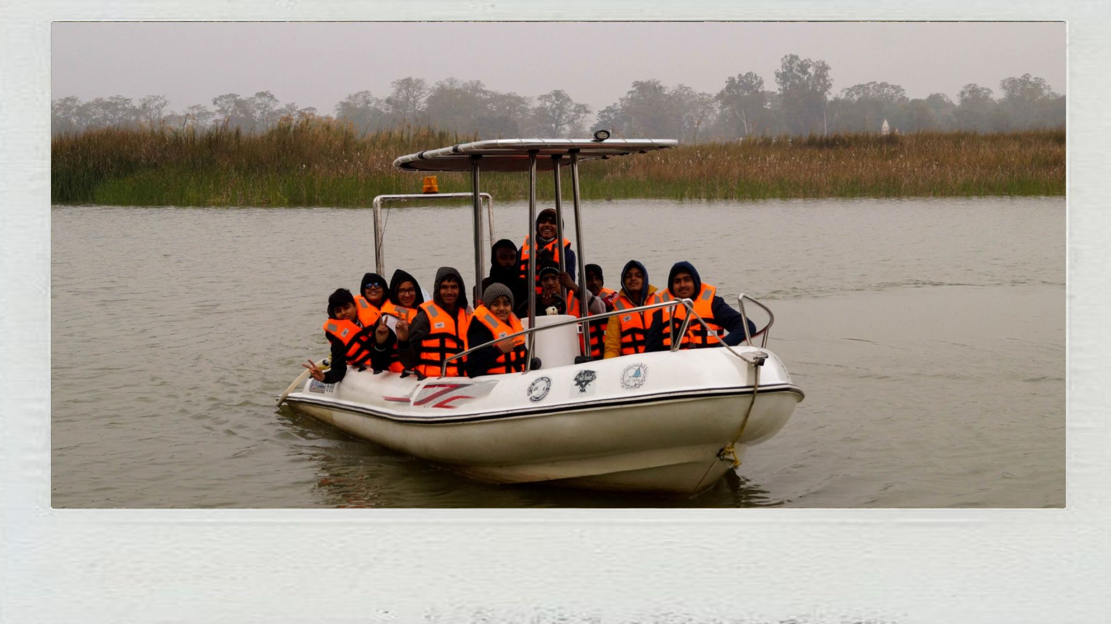
AMAZON-LIKE BOAT CRUISE
Visit Katerniyaghat, where rare is common

Slide 21
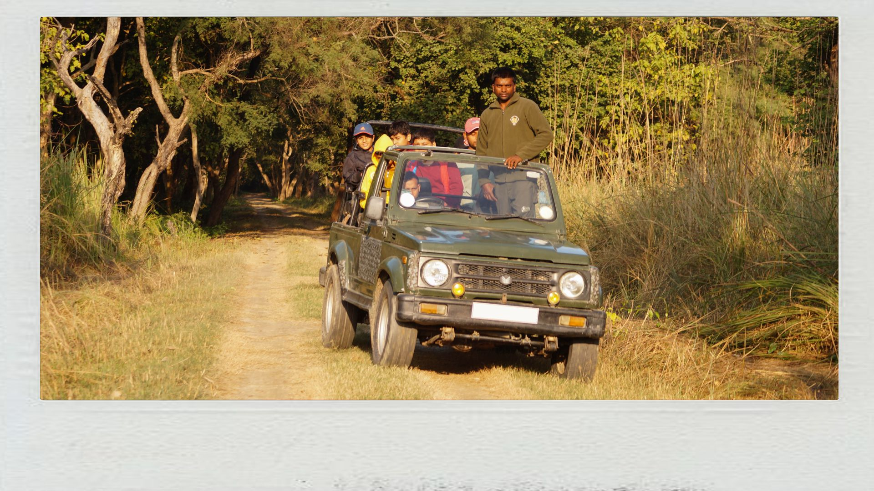
JUNGLE JEEP SAFARI
Experience the dense Sal forest of the Terai on wheels

Slide 22
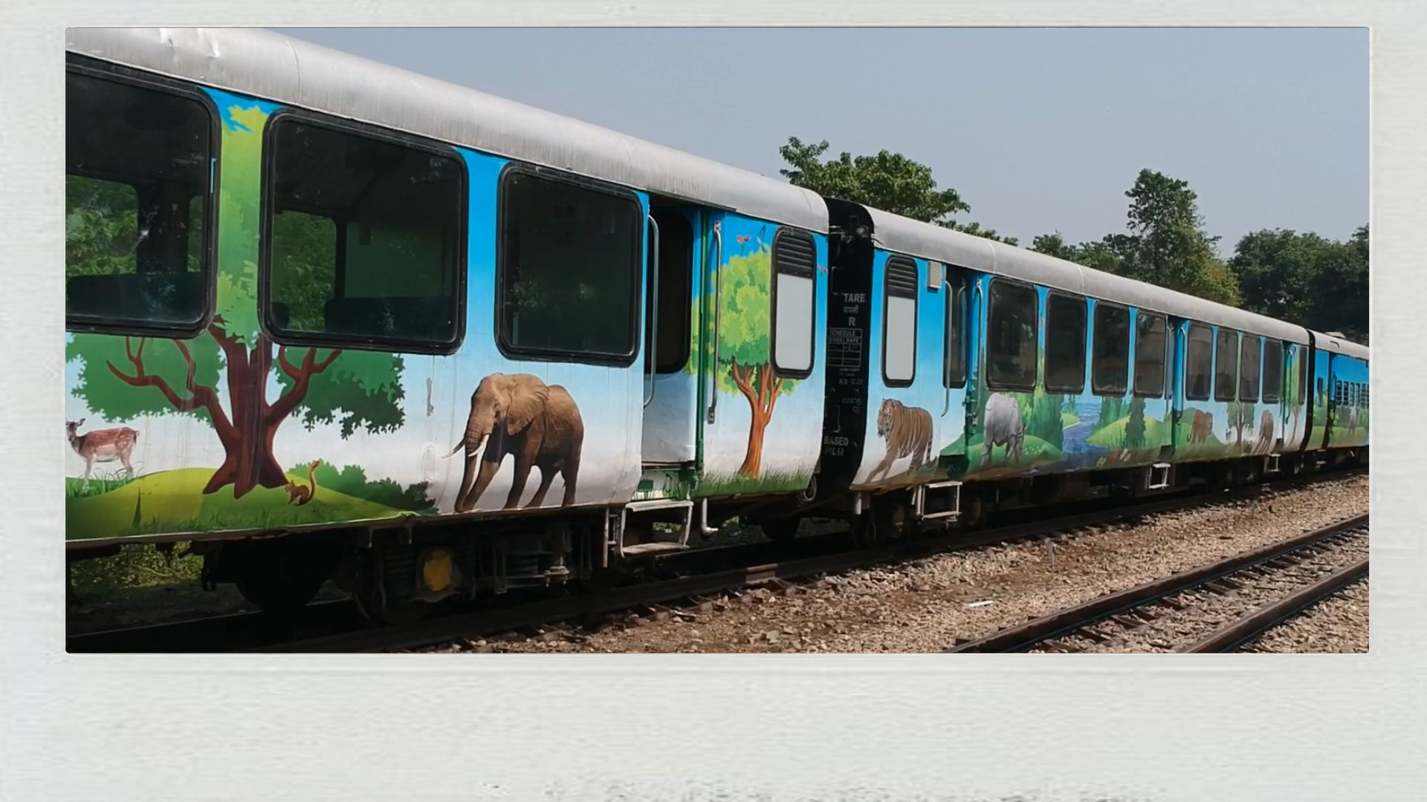
ONLY TIGER RESERVE WITH VISTADOME TRAIN SAFARI
Movie like experience on the on-going train seeing all habitats

Slide 23
Thank you, We Invite your Institution at our camp. www.dudhwanationalpark.org

